Slide 1
“Online Internet Banking”
Presented By :
Rushabh Wadkar (80)
Kunal Shinde (67)
Swapnil Velunde (79)
Tejas Zarekar (83)

Slide 2
INDEX
Introduction
Problem Definition
System Requirement
System Design
Project Snap shots
Conclusion

Slide 3
Introduction
The online internet banking web application is intended to provide complete solution for bank customers/users through a single getway using the internet as the sole medium. It will enable bank users to withdraw amount, transfer amount and view a mini-statement of the last 5 transactions without having to visit the bank physically.

Slide 4
Problem Definition
This 'Online Banking' Project is a model Internet Banking Site. This site enables the customers to perform the basic banking transactions by sitting at their office or at homes through PC or laptop. The customers can access the banks website for viewing their Account details and perform the transactions on account as per their requirements.
Internet banking is a product of e-commerce in the field of banking and financial services. In what can be described as business to customer domain for banking industry, Internet banking offers different online services like balance enquiry, balance transfer, opening account, check status etc. Mostly, these are traditional services offered through internet as a new delivery channel.
The Traditional way of maintaining details of a user in a bank was to enter the details and record them. Every time the user need to perform some transactions he has to go to bank and perform the necessary actions, which may not be so feasible all the time. It may be a hard-hitting task for the users and the bankers too. The project gives real life understanding of Online Banking System and activities performed by various roles in the supply chain. Here, we provide an automation for banking system through Internet.
Online Banking System project captures activities performed by different roles in real life banking which provides enhanced techniques for maintaining the required information up to date, which results in efficiency. The project gives real life understanding of Online Banking System and activities performed by various roles in the supply chain.

Slide 5
System Requirement
Functional requirement of the customer is to view Bank Account Balance.
Customer can create an account.
Customer can transfer funds to another account in the same bank.
Customer can withdraw money from their account.
Customer can request details of the last 5 number of transaction he has performed on account.

Slide 6
System Design
UML (Unified Modeling Language) is standard language of writing software blue prints.
UML is a language that provides vocabulary and rules for combining words in that vocabulary for the purpose of communication.
A modeling language is a language whose vocabulary and rules focus on the concept and physical representation of a system.

Slide 7
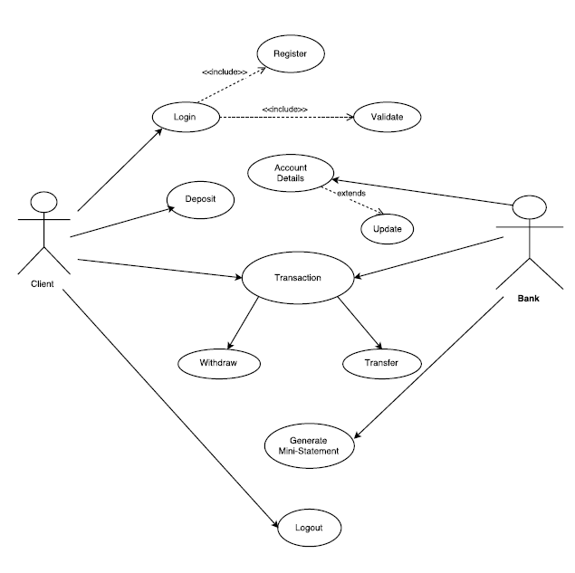
Use case

Slide 8
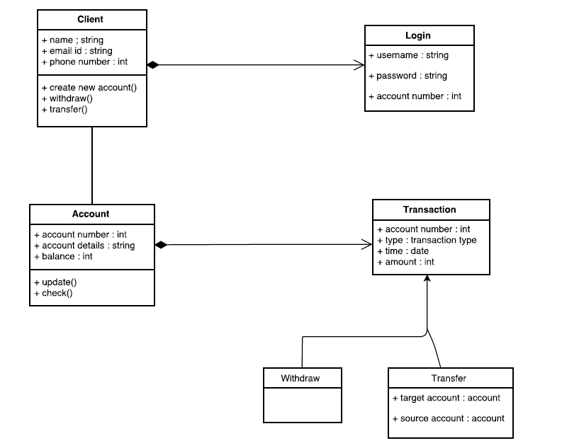
Class Diagram

Slide 9
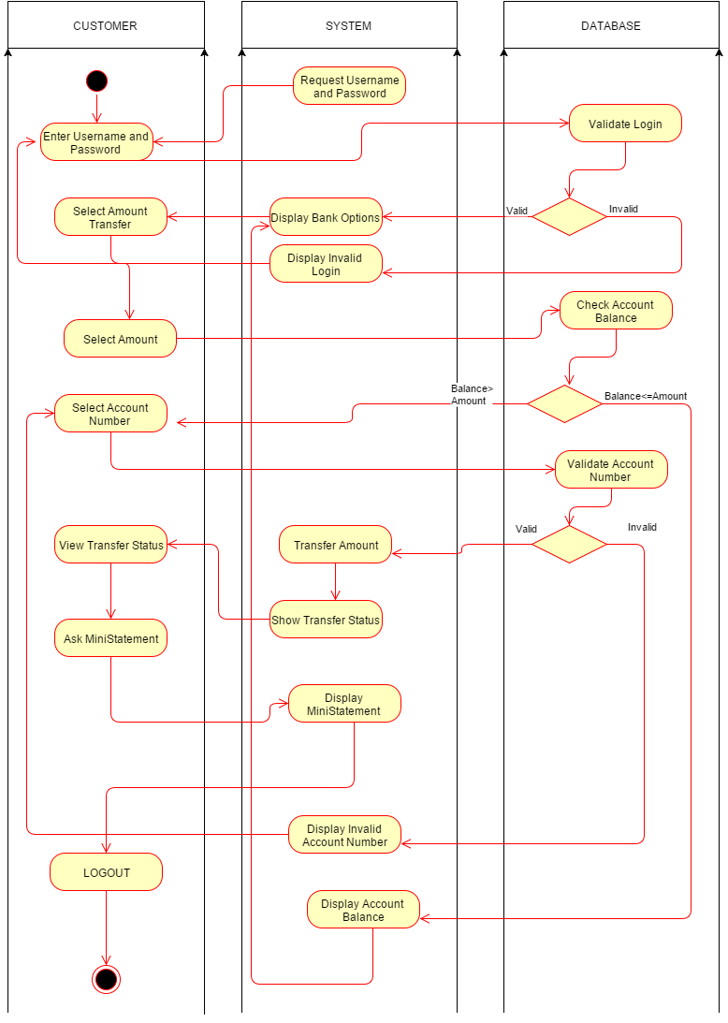

Slide 10
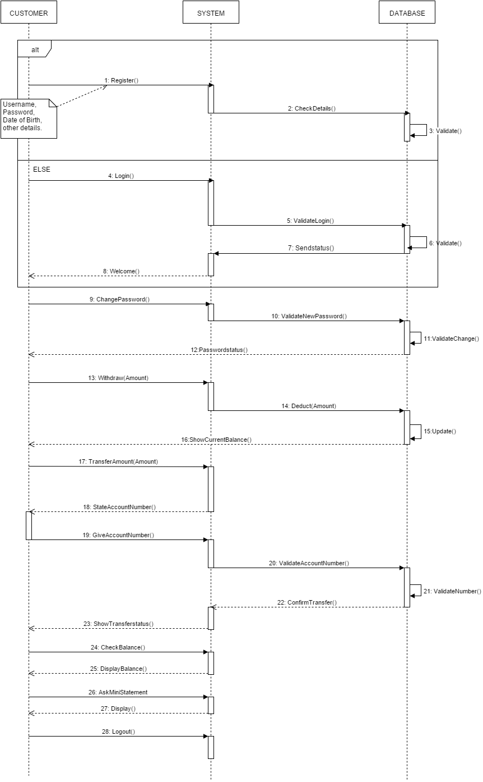

Slide 11
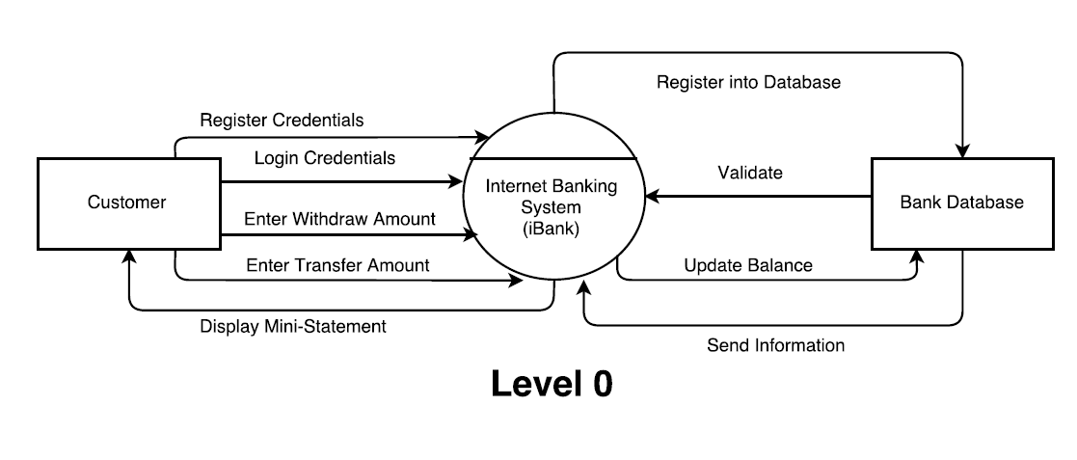
Data Flow Diagram

Slide 12
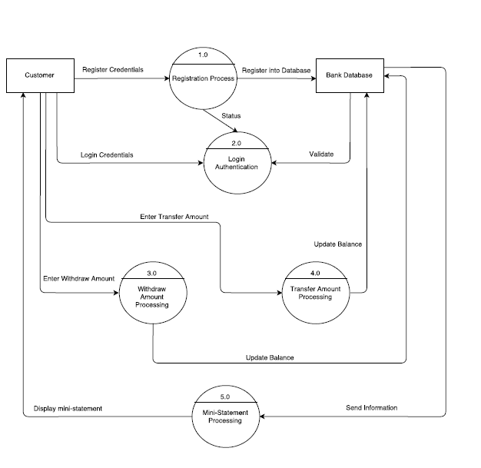
Level 1 DFD

Slide 13
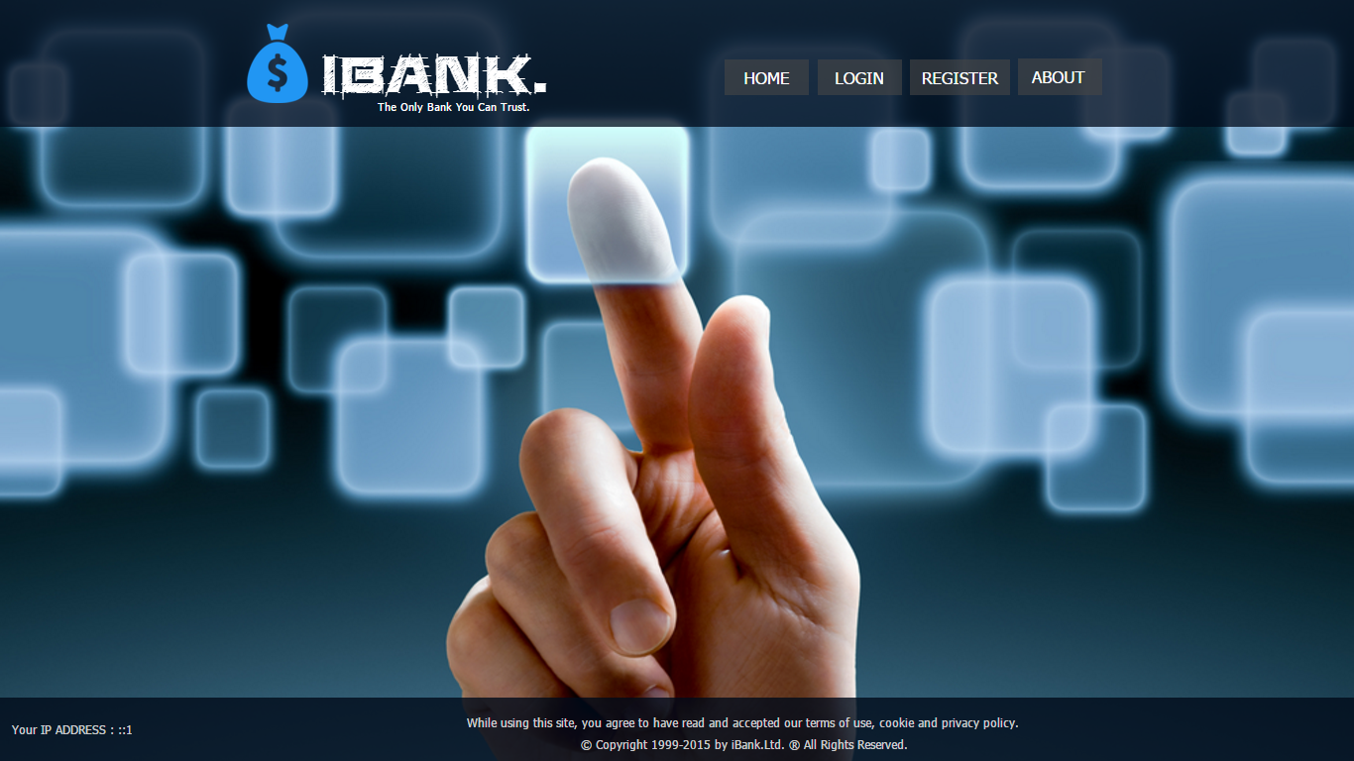
Project Snap Shots

Slide 14
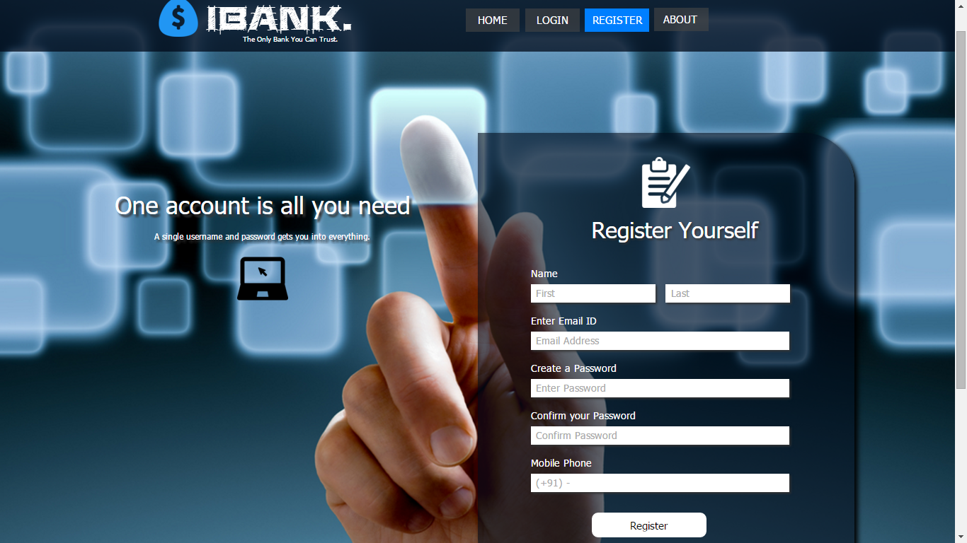

Slide 15
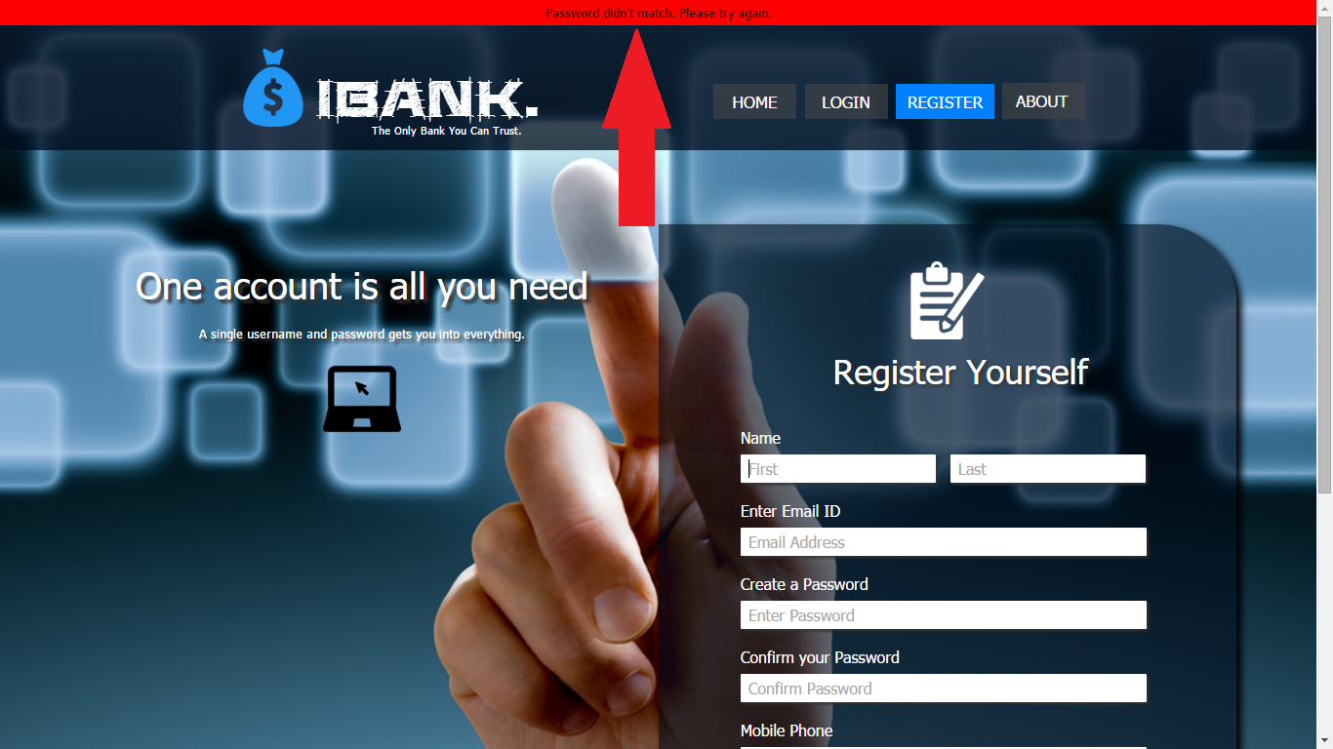

Slide 16
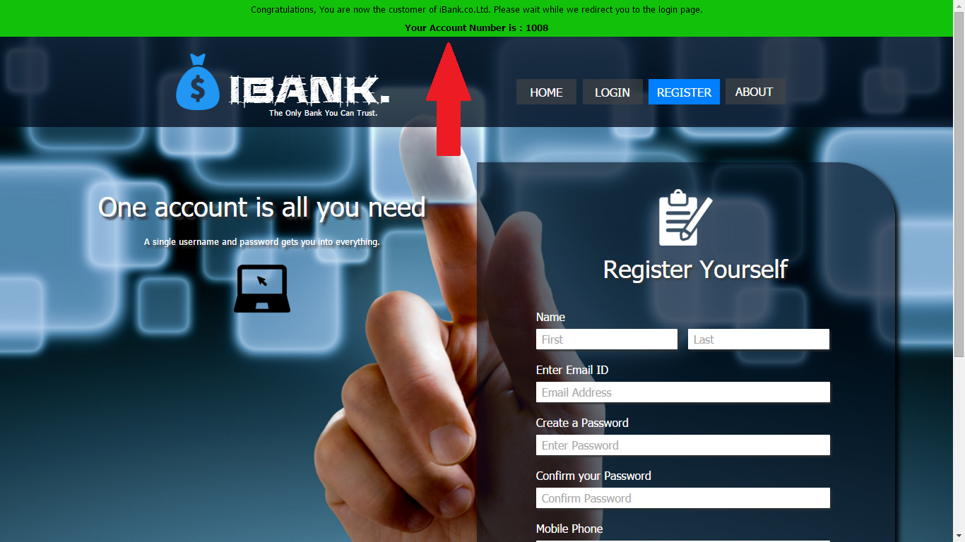

Slide 17
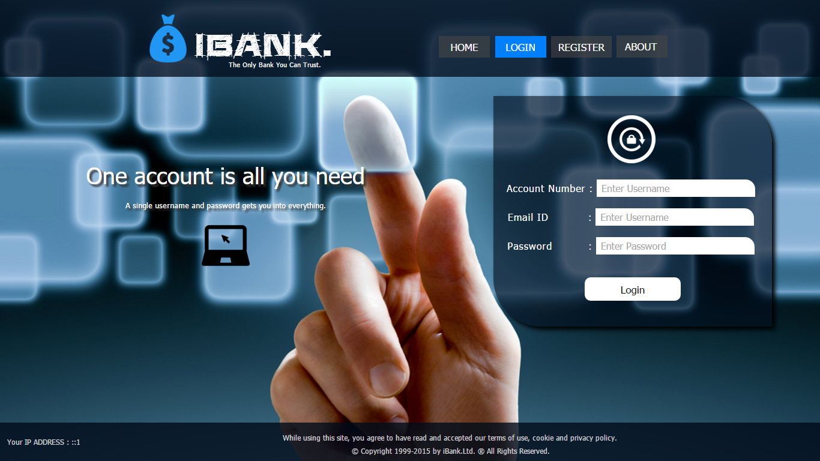

Slide 18
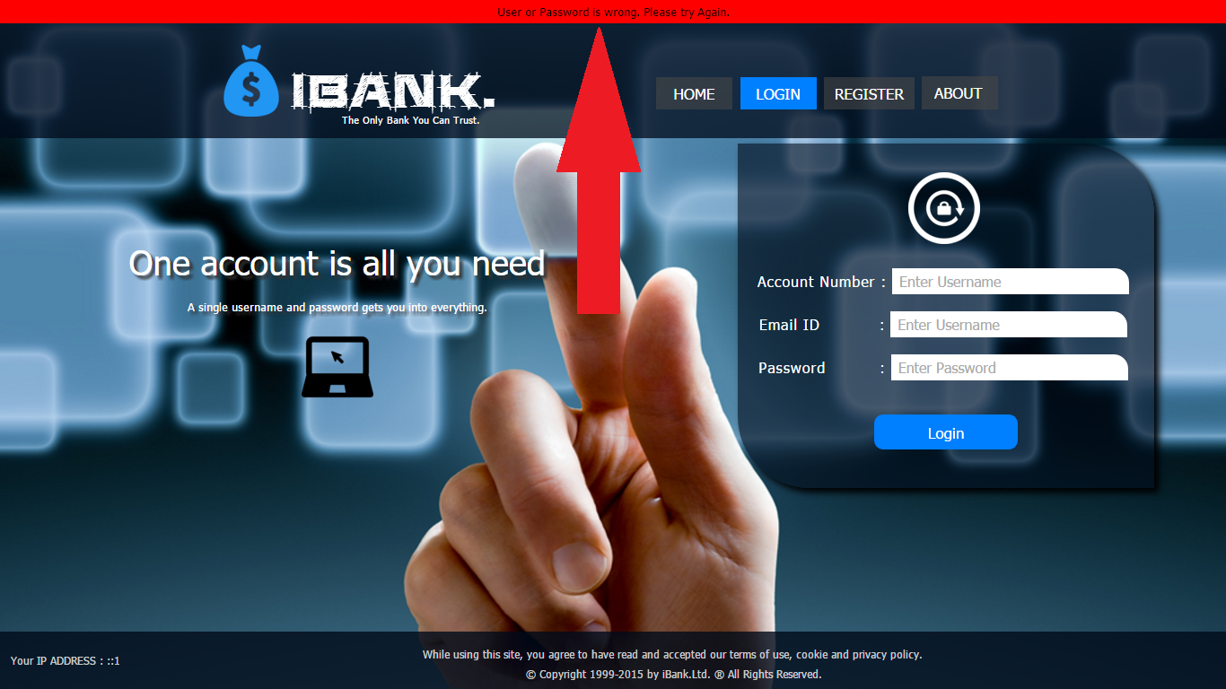

Slide 19
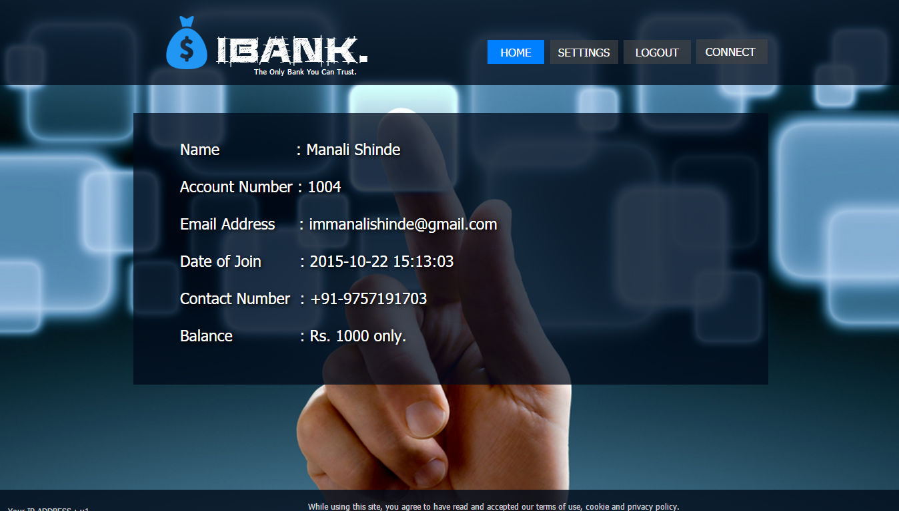

Slide 20
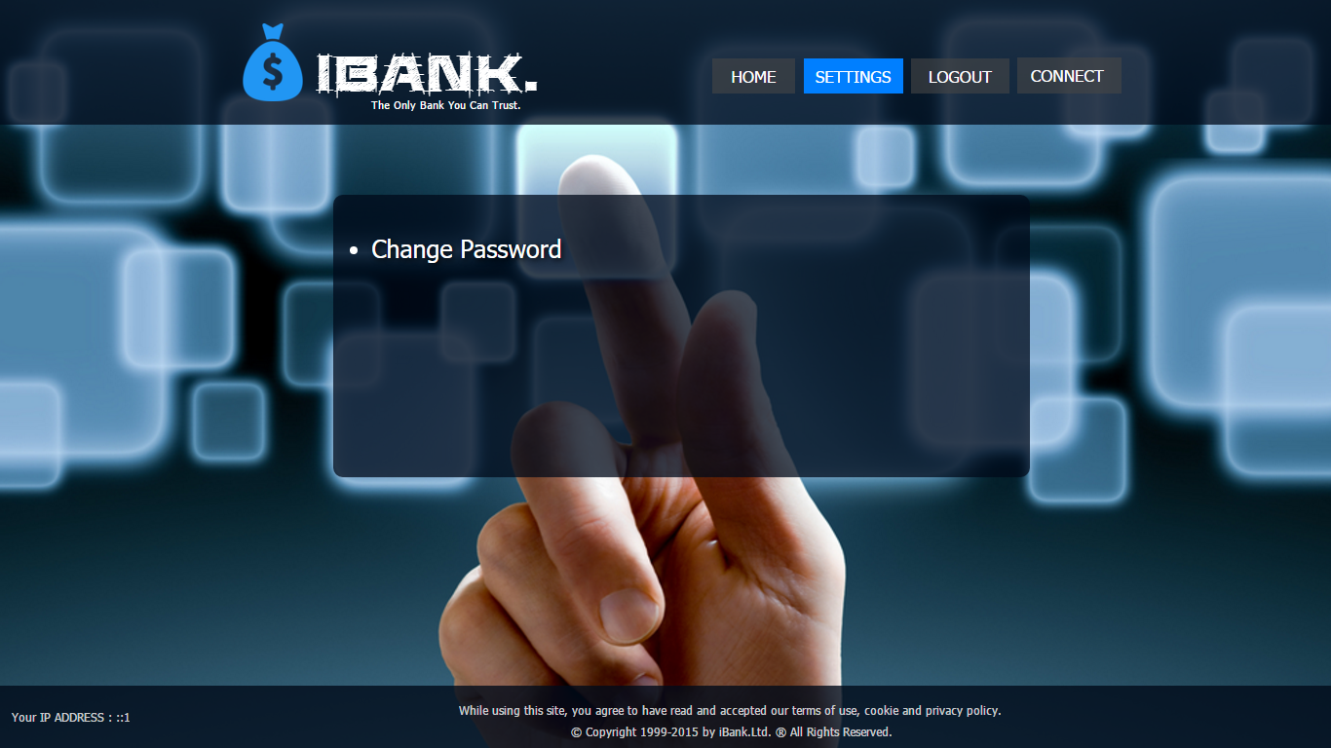

Slide 21
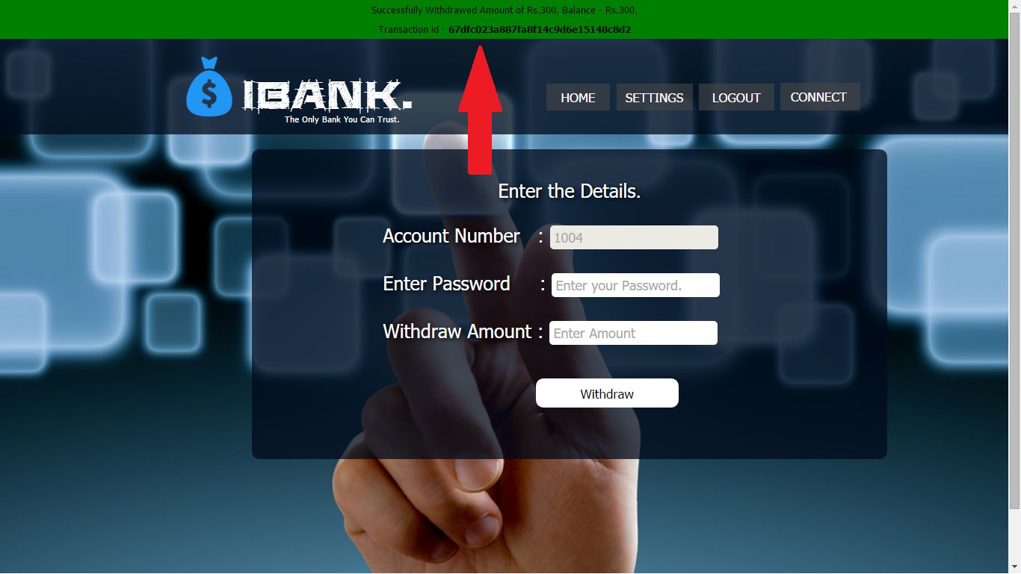

Slide 22
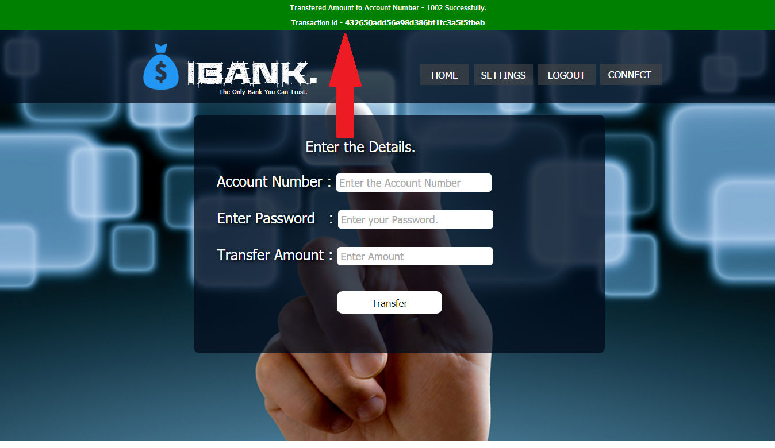

Slide 23


Slide 24
Conclusion
We have successfully completed the online orientation for online Banking. Online Banking System project captures activities performed by different roles in real life banking which provides enhanced techniques for maintaining the required information up to date, which results in efficiency. The project gives real life understanding of Online Banking System and activities performed by various roles in the supply chain.
Online banking is very advantageous as it is user friendly, quick to access and reliable software.

